Slide 1
QMST 5335
Time Series, Simple Methods, and Forecast Errors

Slide 2
Learning Objectives:
Basics of Time Series
  What is a time series? What are the patterns that can be observed?
  Visualization tools and measures to detect patterns
  Components of time series and decomposition
Simple forecasting tools
  Some simple methods for forecasting and their implementation
  Moving Average method for forecasting
Forecast errors
  How are they calculated?
  How can we use them in forecasting?

Slide 3
Outline
Time Series
  Patterns, Graphics, Autocorrelation, and Stationarity
  Components, Moving Averages, and Decomposition
Simple Forecasting Methods
  Notation and Methods
  Forecasting with Moving Average Method
Forecast Errors
  Errors and Measures

Slide 4
Outline
Time Series
  Patterns, Graphics, Autocorrelation, and Stationarity
  Components, Moving Averages, and Decomposition
Simple Forecasting Methods
  Notation and Methods
  Forecasting with Moving Average Method
Forecast Errors
  Errors and Measures

Slide 5
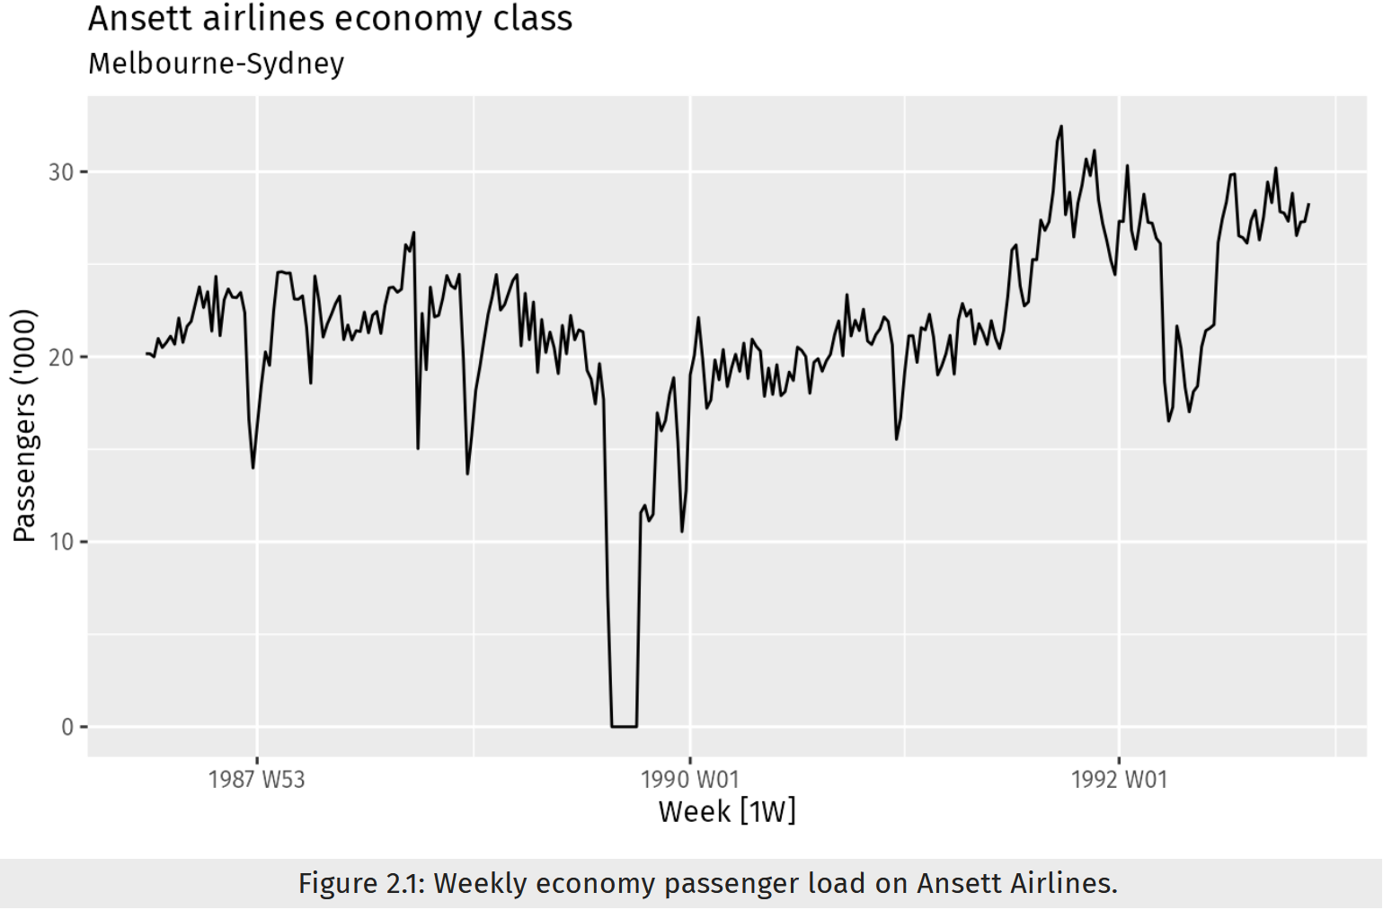
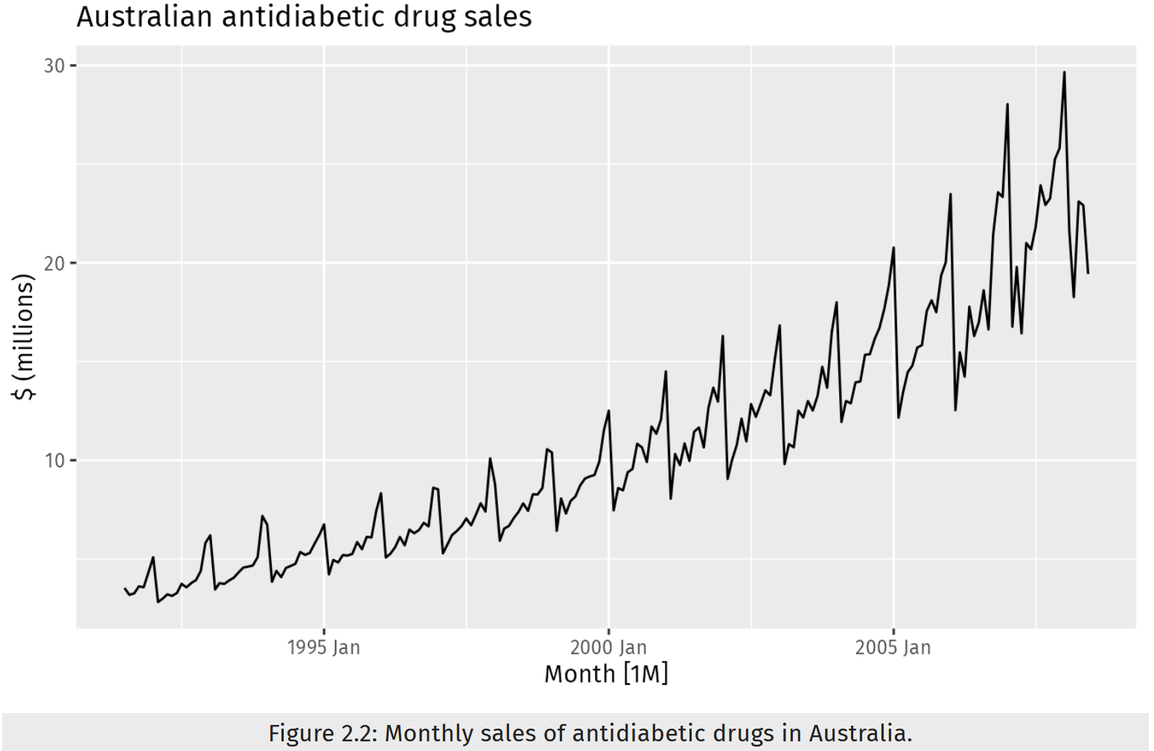
Time Series
Time series data: data collected at regular intervals over time for a particular value
  Daily sales over two years, monthly consumption over 5 years…
Time plot: Observations plotted against time

Slide 6
Time Series Patterns
Patterns are used to describe time series
  Trend: a stable pattern of growth or decline
    A trend exists when there is a long-term increase or decrease in the data
    It does not have to be linear
  Seasonal: a pattern repeating at fixed intervals
    A seasonal pattern occurs when a time series is affected by seasonal factors such as the time of the year or the day of the week
    Seasonality is always of a fixed and known frequency
  Cyclic: similar to seasonality but length and magnitude of the cycle may vary
    A cycle occurs when the data exhibit rises and falls that are not of a fixed frequency
    Different than seasonality!
    Cycles are typically due to “business cycles”
    The duration of the fluctuations is usually at least 2 years

Slide 7
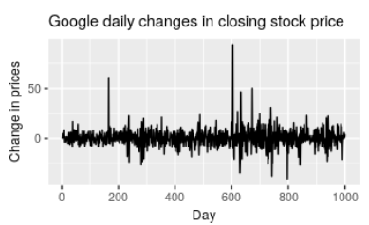
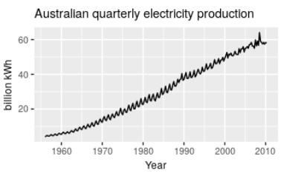
Time Series Patterns
Examples of time series with different characteristics:
The daily change in the Google closing stock price has no trend, seasonality or cyclic behavior. There are random fluctuations which do not appear to be very predictable, and no strong patterns that would help with developing a forecasting model.
The Australian quarterly electricity production shows a strong increasing trend, with strong seasonality. There is no evidence of any cyclic behavior here.

Slide 8
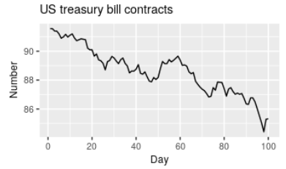
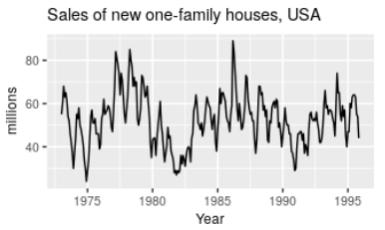
Time Series Patterns
Examples of time series with different characteristics:
The US treasury bill contracts show results from the Chicago market for 100 consecutive trading days in 1981. Here there is no seasonality, but an obvious downward trend.
The monthly housing sales show strong seasonality within each year, as well as some strong cyclic behavior with a period of about 6–10 years. There is no apparent trend in the data over this period.

Slide 9
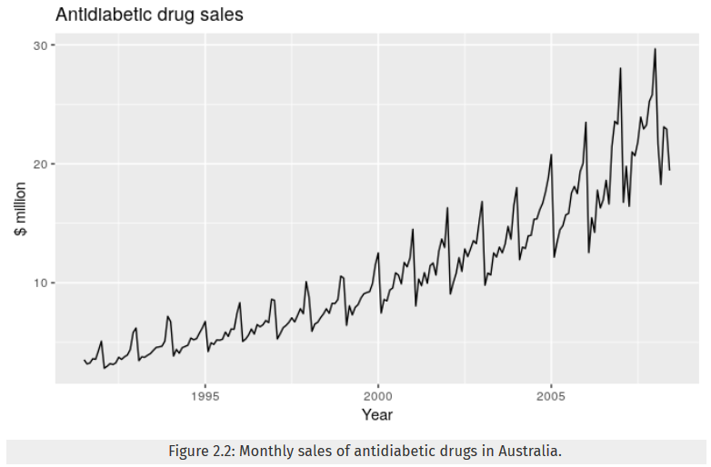
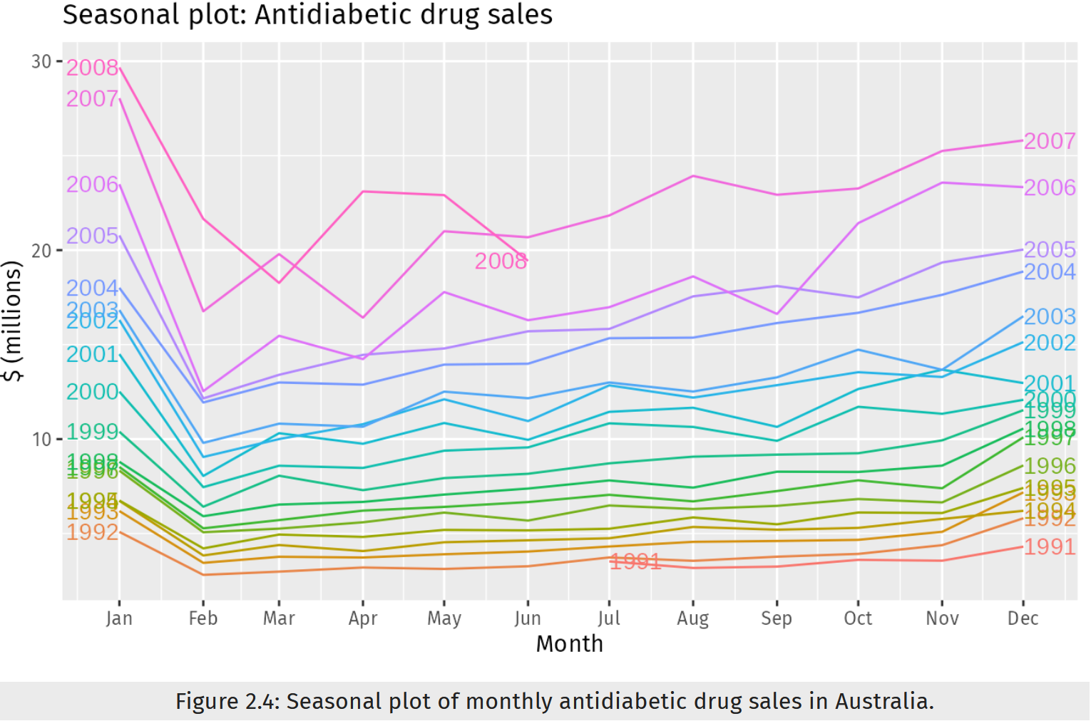
Time Series Graphics: Seasonal Plots
Plot a ‘time plot’ for each season
Here, there is a clear increasing trend. There is also a strong seasonal pattern
The seasonal plot shows the underlying seasonal pattern

Slide 10
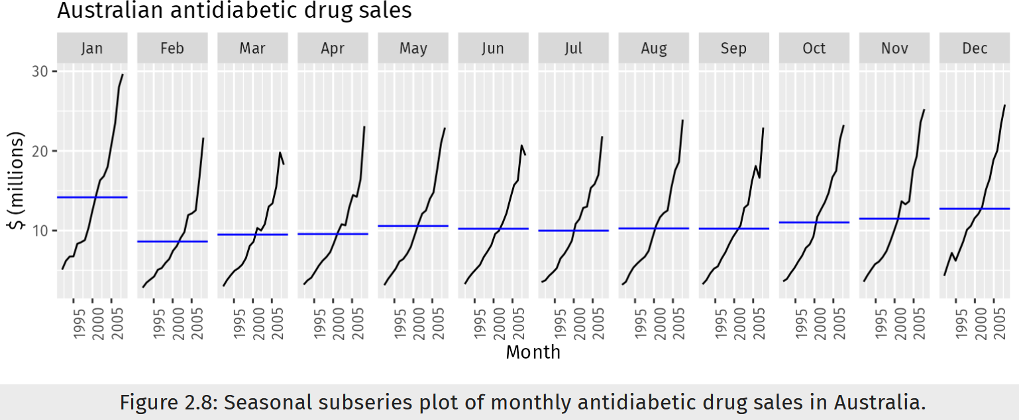
Time Series Graphics: Seasonal Subseries Plots
Data for each season are collected together in separate mini time plots
Blue lines are the means for each month.
Here, there is a clear increasing trend. There is also a strong seasonal pattern

Slide 11
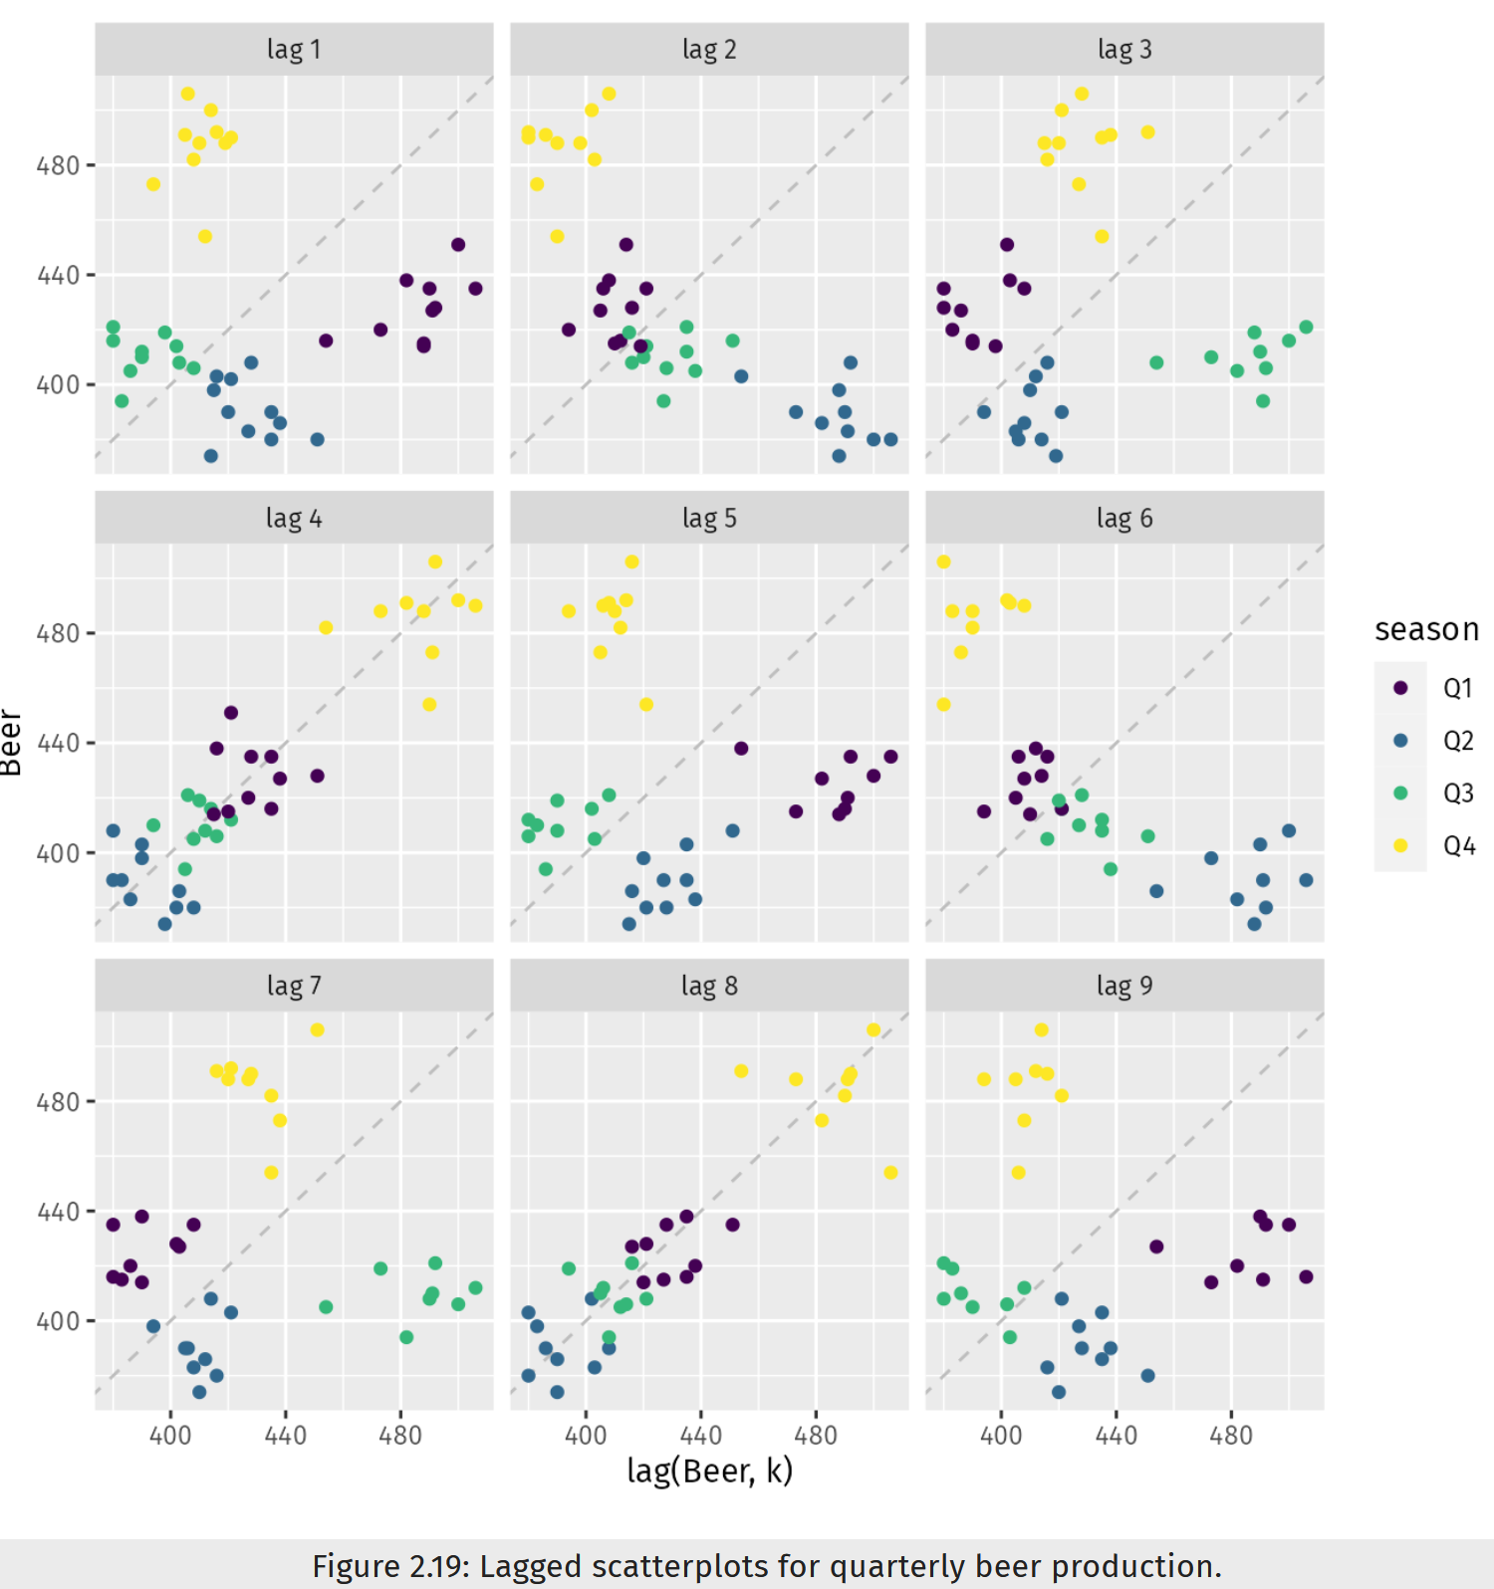
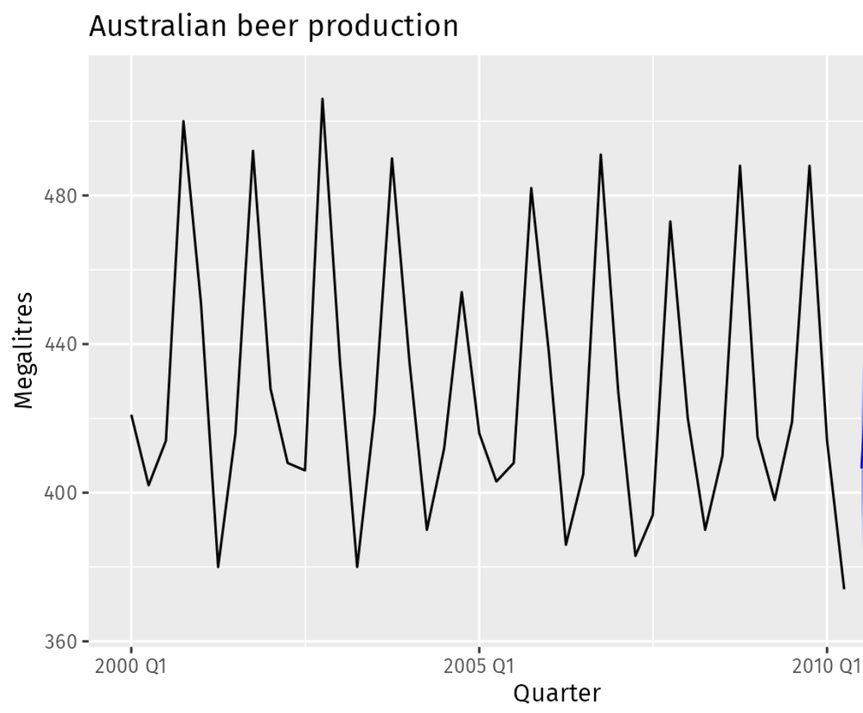

Time Series Graphics: Lag Plots
Scatter plots of a variable ($y_{t}$) in vertical axis vs. its lagged value ($y_{t−k}$) in horizontal axis
Lag 4 and lag 8 show strong relationship, suggesting seasonality in the data.

Slide 12
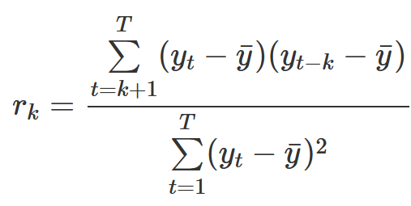
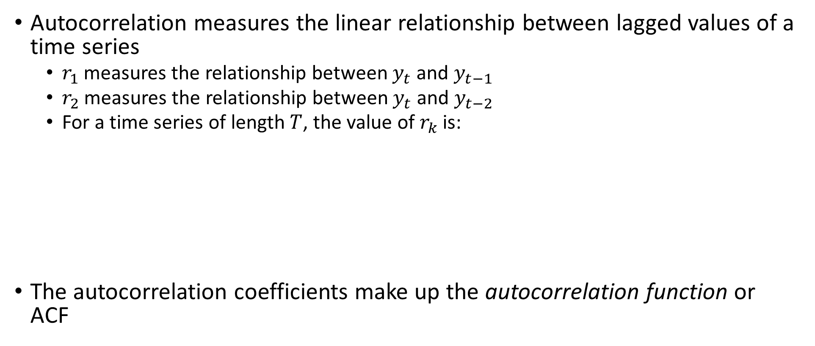
Time Series: Autocorrelation
Autocorrelation measures the linear relationship between lagged values of a time series
  $r_{1}$ measures the relationship between $y_{t}$ and $y_{t−1}$
  $r_{2}$ measures the relationship between $y_{t}$ and $y_{t−2}$
  For a time series of length $T$, the value of $r_{k}$ is:
The autocorrelation coefficients make up the autocorrelation function or ACF

Slide 13
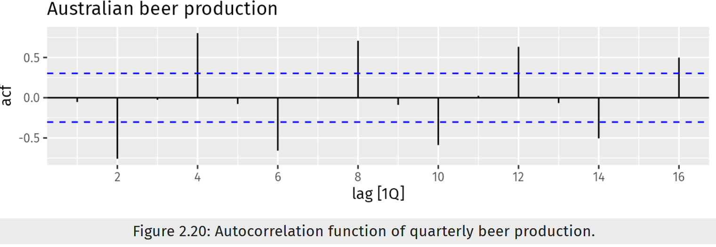

Time Series: Autocorrelation
We usually plot the ACF to see how the correlations change with the lag $k$
  $r_{4}$ is higher than for the other lags. This is due to the seasonal pattern in the data: the peaks tend to be four quarters apart and the troughs tend to be four quarters apart
  $r_{2}$ is more negative than for the other lags because troughs tend to be two quarters behind peaks

Slide 14
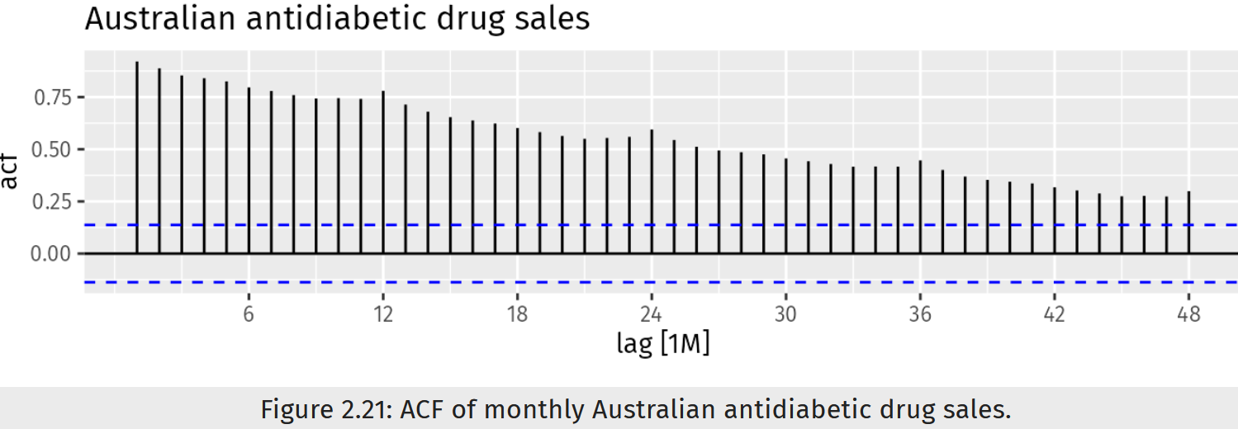

Time Series: Autocorrelation
We usually plot the ACF to see how the correlations change with the lag $k$
  When data have a trend, the autocorrelations for small lags tend to be large and positive because observations nearby in time are also nearby in value
    So the ACF of a trended time series tends to have positive values that slowly decrease as the lags increase
  When data are seasonal, the autocorrelations will be larger for the seasonal lags (at multiples of the seasonal period) than for other lags
  When data are both trended and seasonal, you see a combination of these effects

Slide 15
Stationarity
A stationary time series is one whose statistical properties do not depend on the time at which the series is observed
  A time series that is not stationary is non-stationary
  Some forecasting methods work on stationary time series
Time series with trend and/or with seasonality are not stationary
  Trend and seasonality affect the value of time series at different times
White noise series is stationary
  Time series that show no autocorrelation are called white noise
  It does not matter when you observe it, it should look much the same at any point in time
A time series with cyclic behavior (but with no trend or seasonality) is stationary
  Cycles are not of a fixed length, so before we observe the series, we cannot be sure where the peaks and bottoms of the cycles will be

Slide 16
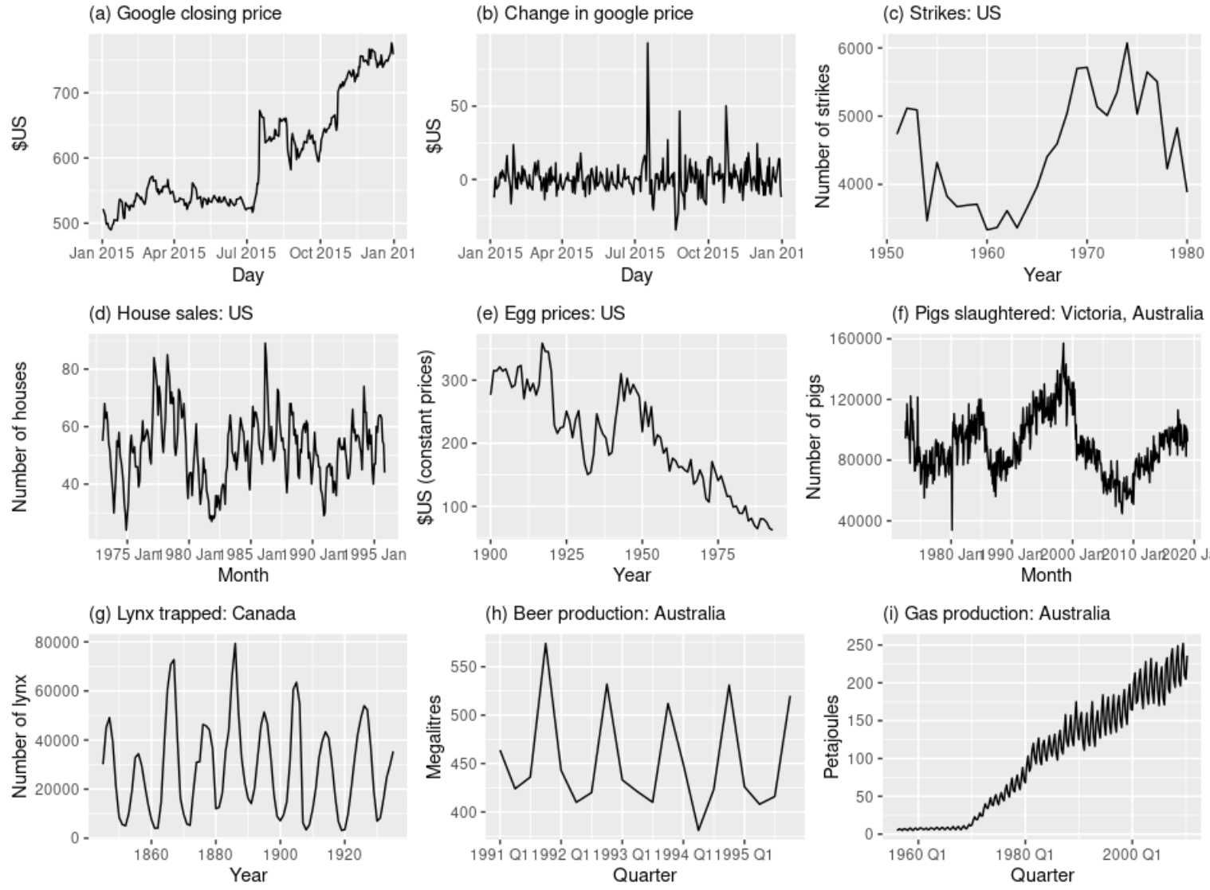
Stationarity
(d), (h), (i) have seasonality
(a), (e), (i) have trends
(c), (f) have changing levels
(i) also has increasing variance
In (g), cycles are aperiodic
(b) and (g) are stationary

Slide 17
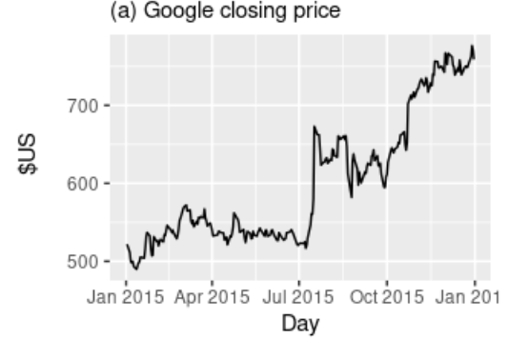
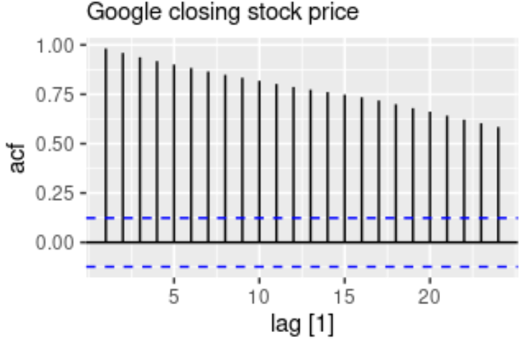
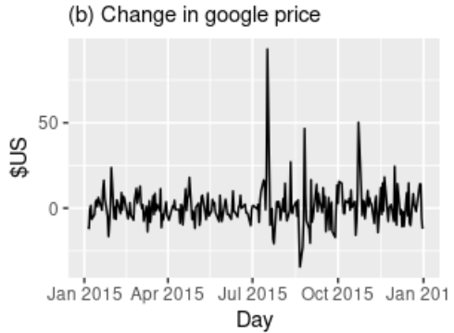
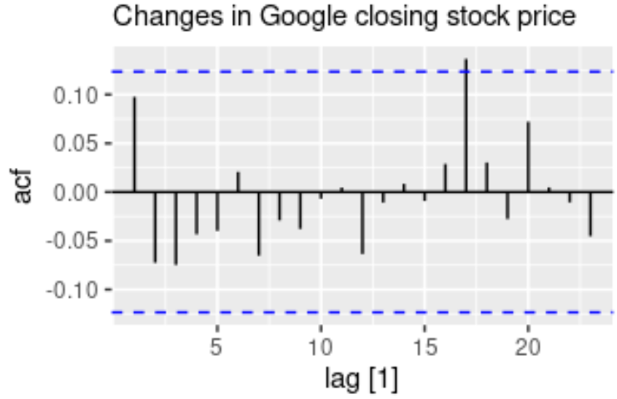
Stationarity
In general, a stationary time series will have no predictable patterns in the long-term
  Time plots will show the series to be roughly horizontal (although some cyclic behavior is possible), with constant variance
As well as the time plot of the data, the Auto Correlation Function (ACF) plot is also useful for identifying non-stationary time series.
  For a stationary time series, the ACF will drop to zero relatively quickly
  The ACF of non-stationary data decreases slowly

Slide 18
Stationarity
Time plots and ACF plots can be used to visually check stationarity
One way to determine more objectively whether a time series is stationary is to use a unit root test
  These are statistical hypothesis tests of stationarity that are designed for determining whether a time series is stationary
  Several unit root tests are available, which are based on different assumptions and may lead to conflicting answers
Kwiatkowski-Phillips-Schmidt-Shin (KPSS) test:
  The null hypothesis is that the data are stationary, and we look for evidence that the null hypothesis is false.
  Small p-values (e.g., <0.05) suggest that time series is non-stationary
  See https://en.wikipedia.org/wiki/Unit_root_test for other tests

Slide 19
Time Series Decomposition
It is often helpful to split a time series into several components, each representing an underlying pattern category
Three main components of a time series:
  Trend-cycle component (trend and cycles are combined, trend for simplicity), a seasonal component, and remainder component (anything that remains)
Adjusting the historical data can often lead to a simpler time series:
  Calendar adjustments
    Some months might have more work-days: e.g., compute avg value sales per day in each month
  Population adjustments
    Rather than looking at the total, we can look at the data per capita (per person)
  Inflation adjustments
    For data affected by the value of money, inflation adjustments can be needed
  Mathematical transformations: when variations change over time

Slide 20
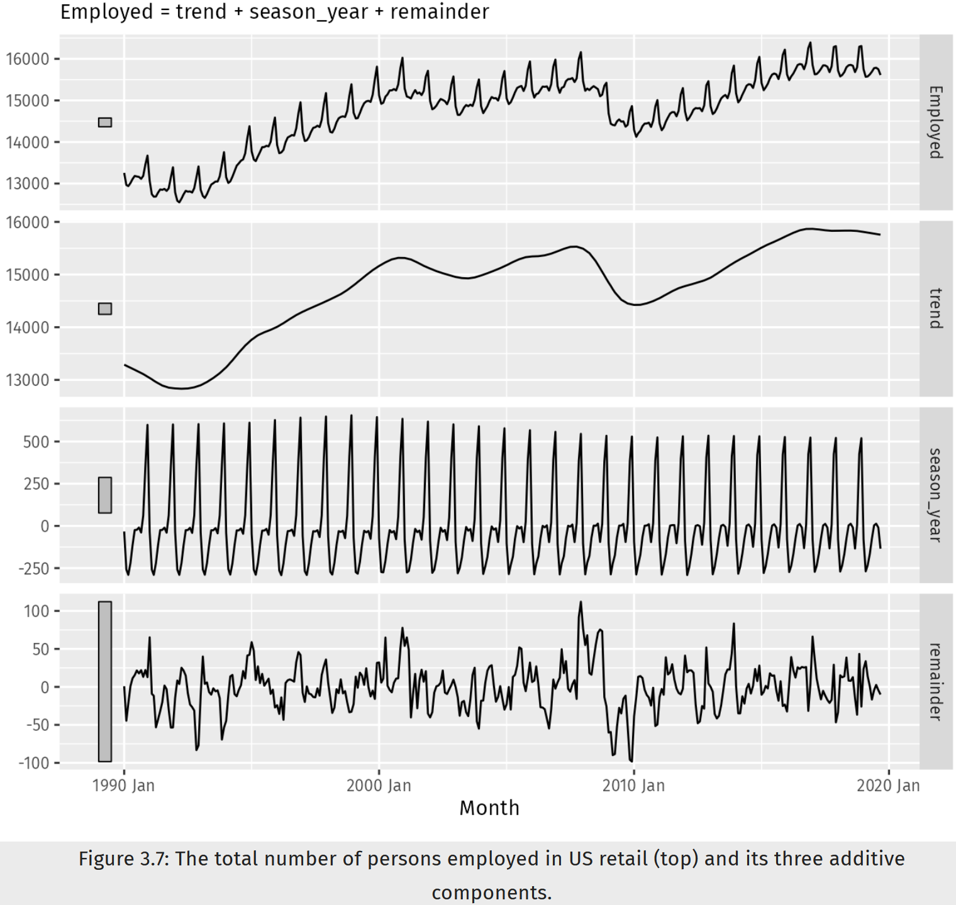
Time Series Decomposition
Two main ways to decompose a time series
  Additive:
  S = trend-cycle + seasonal + remainder
    The additive decomposition is the most appropriate if the magnitude of the seasonal fluctuations, or the variation around the trend, does not vary with the level of the time series
  Multiplicative:
  S = trend-cycle x seasonal x remainder
    When the variation in the seasonal pattern, or the variation around the trend-cycle, appears to be proportional to the level of the time series, then a multiplicative decomposition is more appropriate

Slide 21
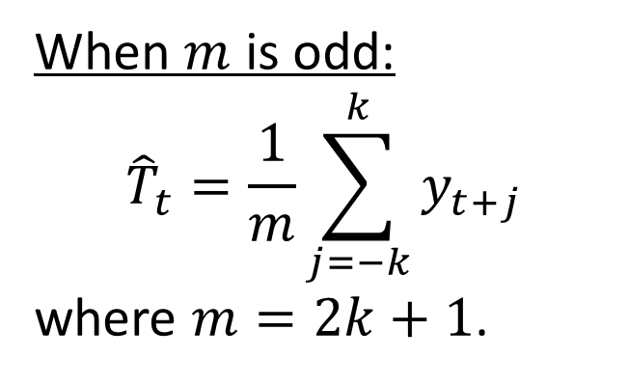
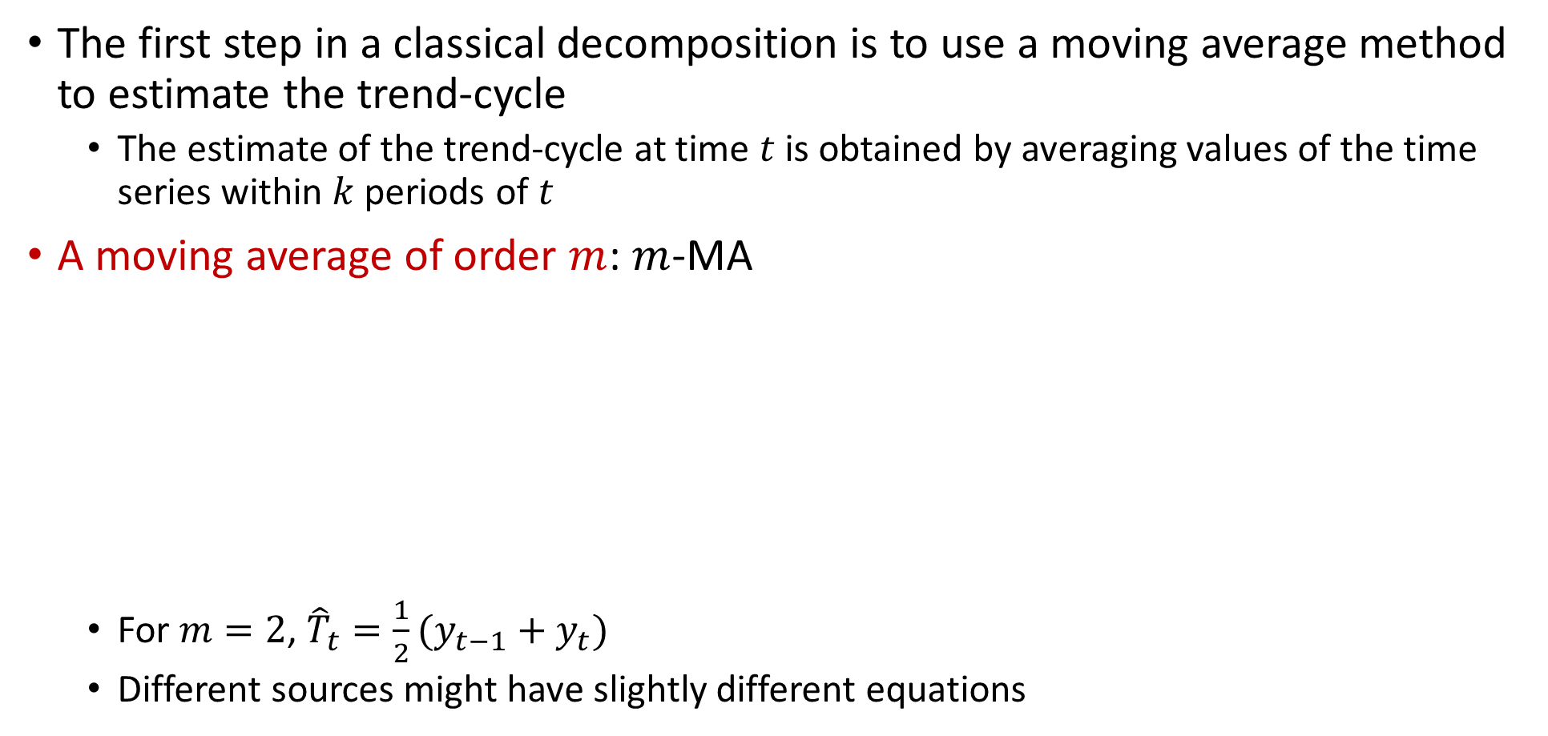
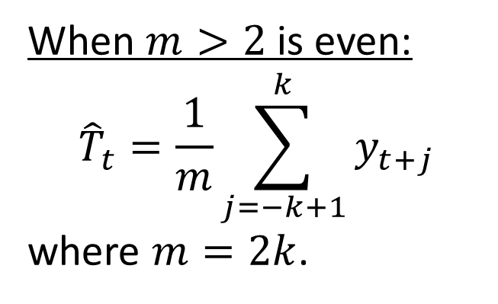
Moving Averages
The first step in a classical decomposition is to use a moving average method to estimate the trend-cycle
  The estimate of the trend-cycle at time $t$ is obtained by averaging values of the time series within $k$ periods of $t$
A moving average of order $m$: $m$-MA
  For $m=2$, ${\hat{T}}_{t}=\frac{1}{2}(y_{t−1}+y_{t})$
  Different sources might have slightly different equations
When $m$ is odd:
$${\hat{T}}_{t}=\frac{1}{m}\sum_{j=−k}^{k}{y_{t+j}}$$
where $m=2k+1$.
When $m>2$ is even:
$${\hat{T}}_{t}=\frac{1}{m}\sum_{j=−k+1}^{k}{y_{t+j}}$$
where $m=2k$.

Slide 22
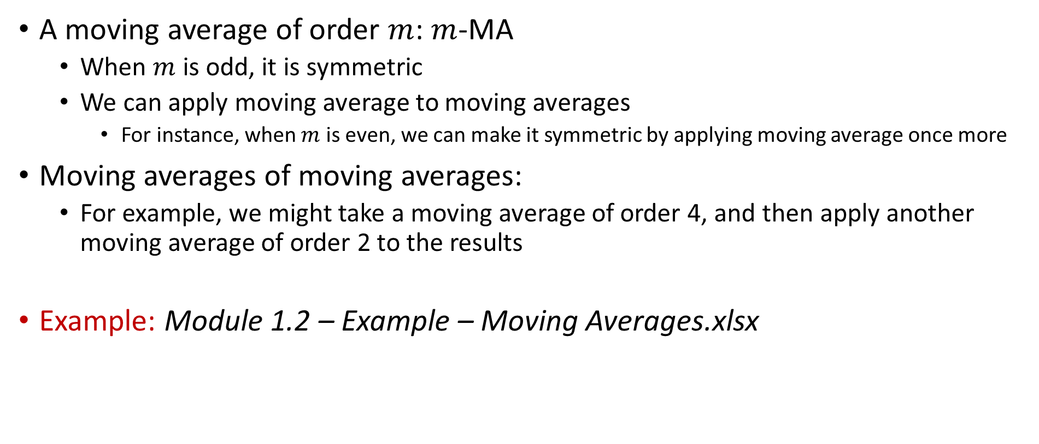
Moving Averages
A moving average of order $m$: $m$-MA
  When $m$ is odd, it is symmetric
  We can apply moving average to moving averages
    For instance, when $m$ is even, we can make it symmetric by applying moving average once more
Moving averages of moving averages:
  For example, we might take a moving average of order 4, and then apply another moving average of order 2 to the results
Example: Module 1.2 – Example – Moving Averages.xlsx

Slide 23
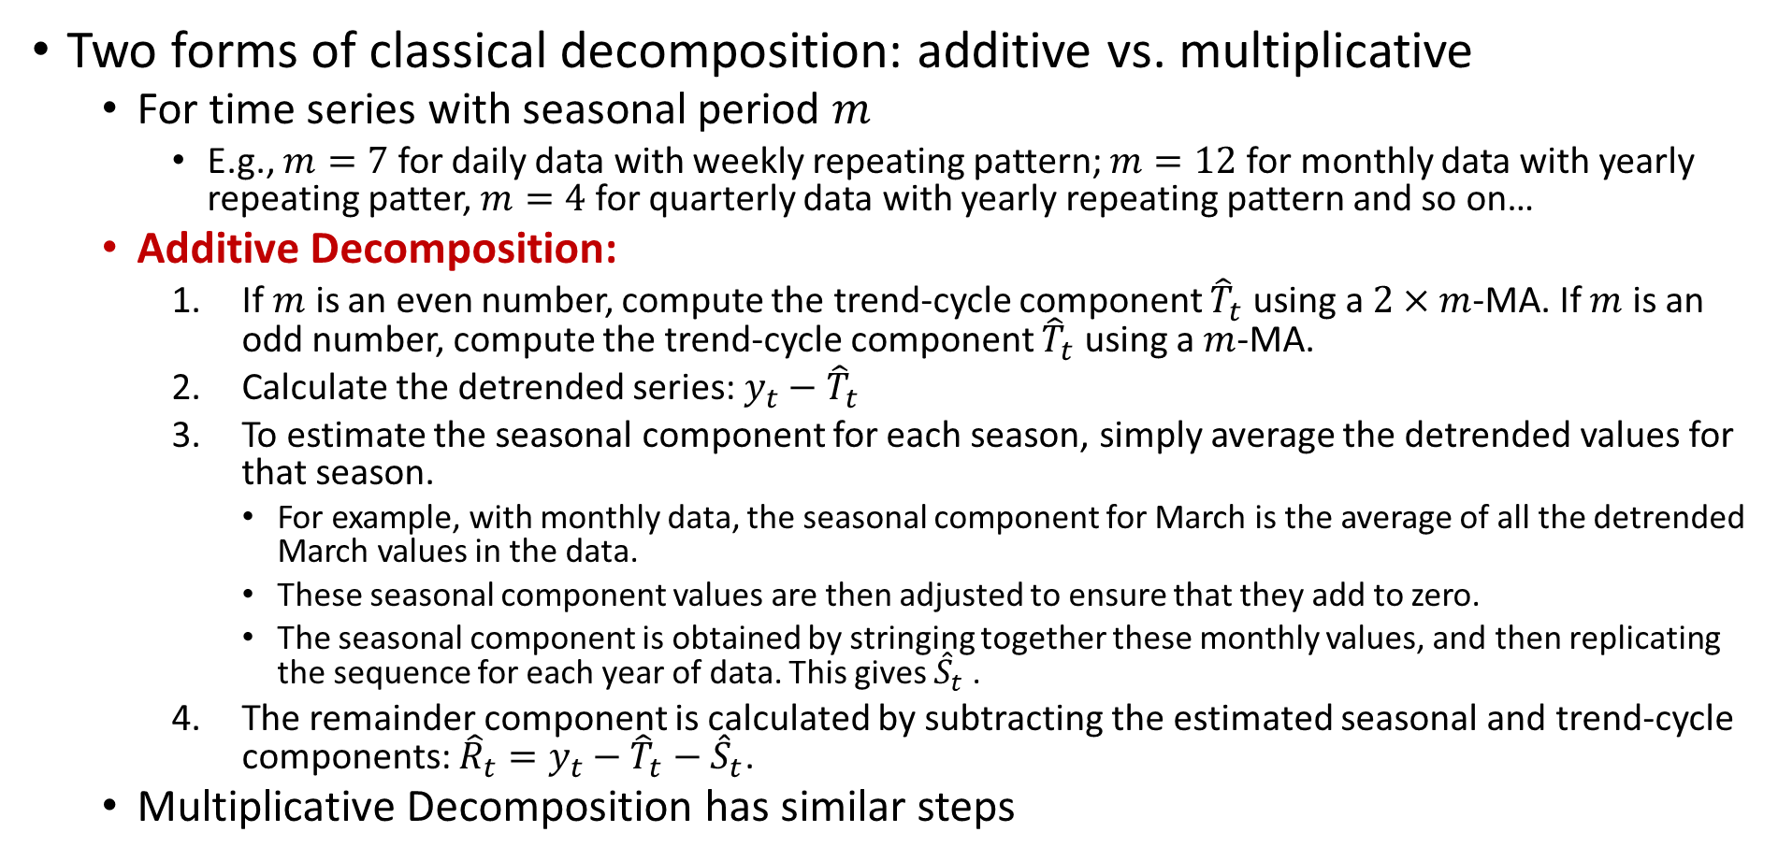
Classical Decomposition
Two forms of classical decomposition: additive vs. multiplicative
  For time series with seasonal period $m$
    E.g., $m=7$ for daily data with weekly repeating pattern; $m=12$ for monthly data with yearly repeating patter, $m=4$ for quarterly data with yearly repeating pattern and so on…
  Additive Decomposition:
    If $m$ is an even number, compute the trend-cycle component ${\hat{T}}_{t}$ using a $2×m$-MA. If $m$ is an odd number, compute the trend-cycle component ${\hat{T}}_{t}$ using a $m$-MA.
    Calculate the detrended series: ${y_{t}−\hat{T}}_{t}$
    To estimate the seasonal component for each season, simply average the detrended values for that season.
      For example, with monthly data, the seasonal component for March is the average of all the detrended March values in the data.
      These seasonal component values are then adjusted to ensure that they add to zero.
      The seasonal component is obtained by stringing together these monthly values, and then replicating the sequence for each year of data. This gives ${\hat{S}}_{t}$ .
    The remainder component is calculated by subtracting the estimated seasonal and trend-cycle components: ${\hat{R}}_{t}={y_{t}−\hat{T}}_{t}−{\hat{S}}_{t}$.
  Multiplicative Decomposition has similar steps

Slide 24
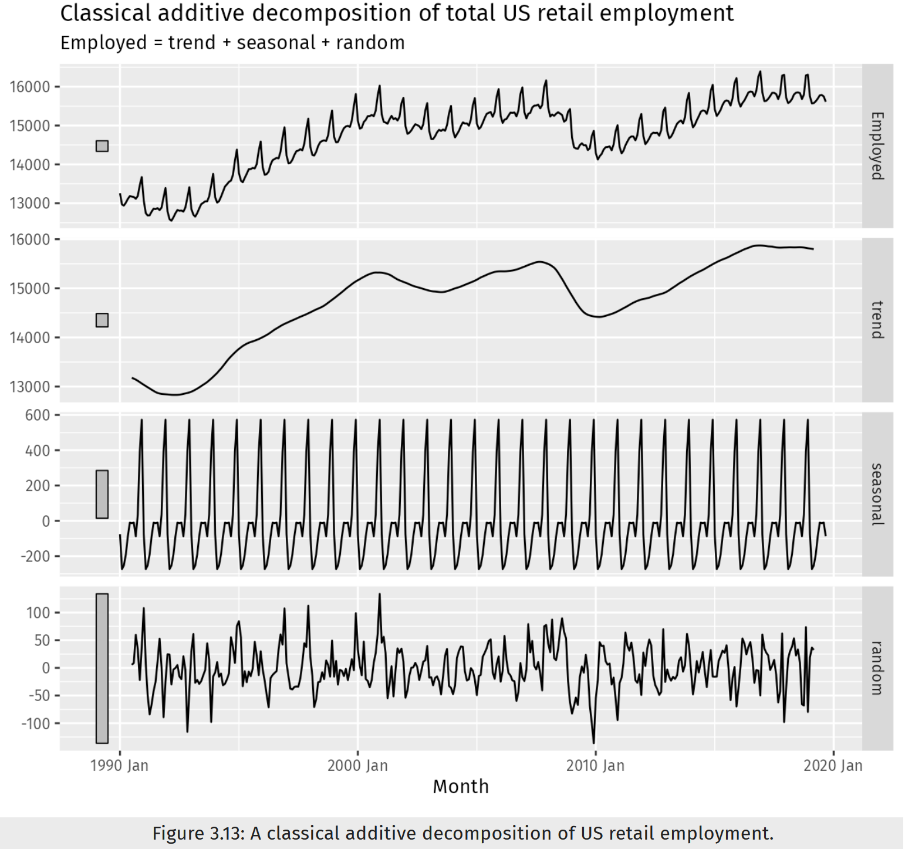
Classical Decomposition
Additive decomposition:
The trend-cycle estimate tends to over-smooth rapid rises and falls in the data.
Classical decomposition methods assume that the seasonal component repeats from year to year.
For first and last few periods, there is no trend-cycle component b/c MA values cannot be calculated for those periods
These are repeating the same values
Example: Module 1.2 – Example – Classical Decomposition.xlsx

Slide 25
Outline
Time Series
  Patterns, Graphics, Autocorrelation, and Stationarity
  Components, Moving Averages, and Decomposition
Simple Forecasting Methods
  Notation and Methods
  Forecasting with Moving Average
Forecast Errors
  Errors and Measures

Slide 26

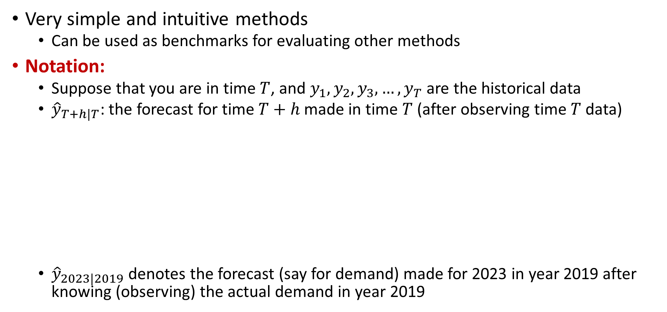
Simple Forecasting Methods
Very simple and intuitive methods
  Can be used as benchmarks for evaluating other methods
Notation:
  Suppose that you are in time $T$, and $y_{1},y_{2},y_{3}, …,y_{T}$ are the historical data
  ${\hat{y}}_{T+h|T}$: the forecast for time $T+h$ made in time $T$ (after observing time $T$ data)
  ${\hat{y}}_{2023|2019}$ denotes the forecast (say for demand) made for 2023 in year 2019 after knowing (observing) the actual demand in year 2019
^ over a variable is used to denote a forecast value. No hat means the observed value
$${\hat{y}}_{T+h|T}$$
When you are making the forecast
For which time, you are making the forecast

Slide 27
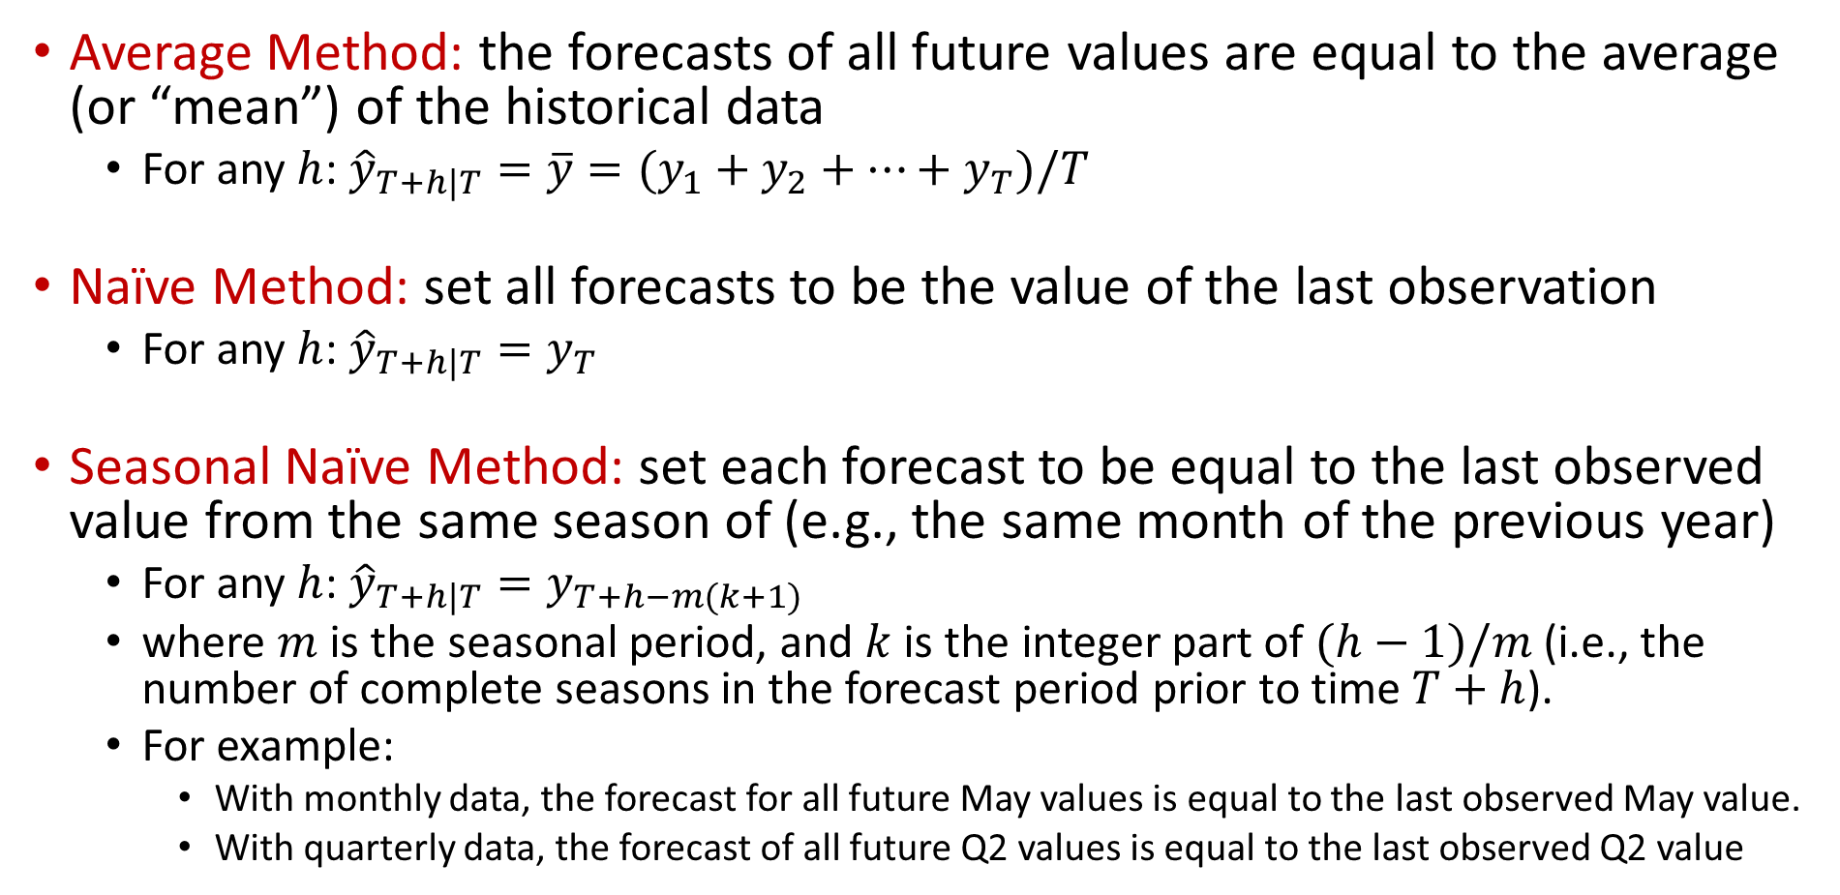
Simple Forecasting Methods
Average Method: the forecasts of all future values are equal to the average (or “mean”) of the historical data
  For any $h$: ${\hat{y}}_{T+h|T}=\overline{y}=(y_{1}+y_{2}+…+y_{T})/T$
Naïve Method: set all forecasts to be the value of the last observation
  For any $h$: ${\hat{y}}_{T+h|T}=y_{T}$
Seasonal Naïve Method: set each forecast to be equal to the last observed value from the same season of (e.g., the same month of the previous year)
  For any $h$: ${\hat{y}}_{T+h|T}=y_{T+h−m(k+1)}$
  where $m$ is the seasonal period, and $k$ is the integer part of $(h−1)/m$(i.e., the number of complete seasons in the forecast period prior to time $T+h$).
  For example:
    With monthly data, the forecast for all future May values is equal to the last observed May value.
    With quarterly data, the forecast of all future Q2 values is equal to the last observed Q2 value

Slide 28
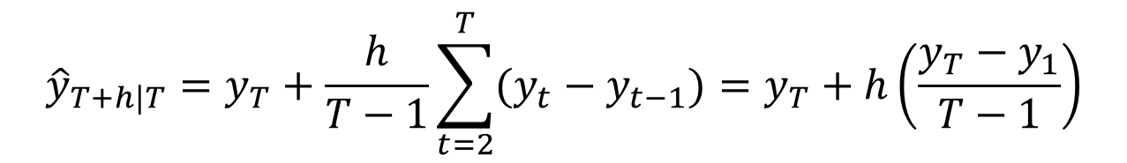
Simple Forecasting Methods
Drift Method: A variation on the naïve method is to allow the forecasts to increase or decrease over time, where the amount of change over time (called the drift) is set to be the average change seen in the historical data
  This is equivalent to drawing a line between the first and last observations, and extrapolating it into the future.
$${\hat{y}}_{T+h|T}=y_{T}+\frac{h}{T−1}\sum_{t=2}^{T}{(y_{t}−y_{t−1})}=y_{T}+h\left(\frac{y_{T}−y_{1}}{T−1}\right)$$
This is the average difference

Slide 29
Simple Forecasting Methods
Example: Module 1.2 – Example – Simple Forecasting Methods.xlsx

Slide 30

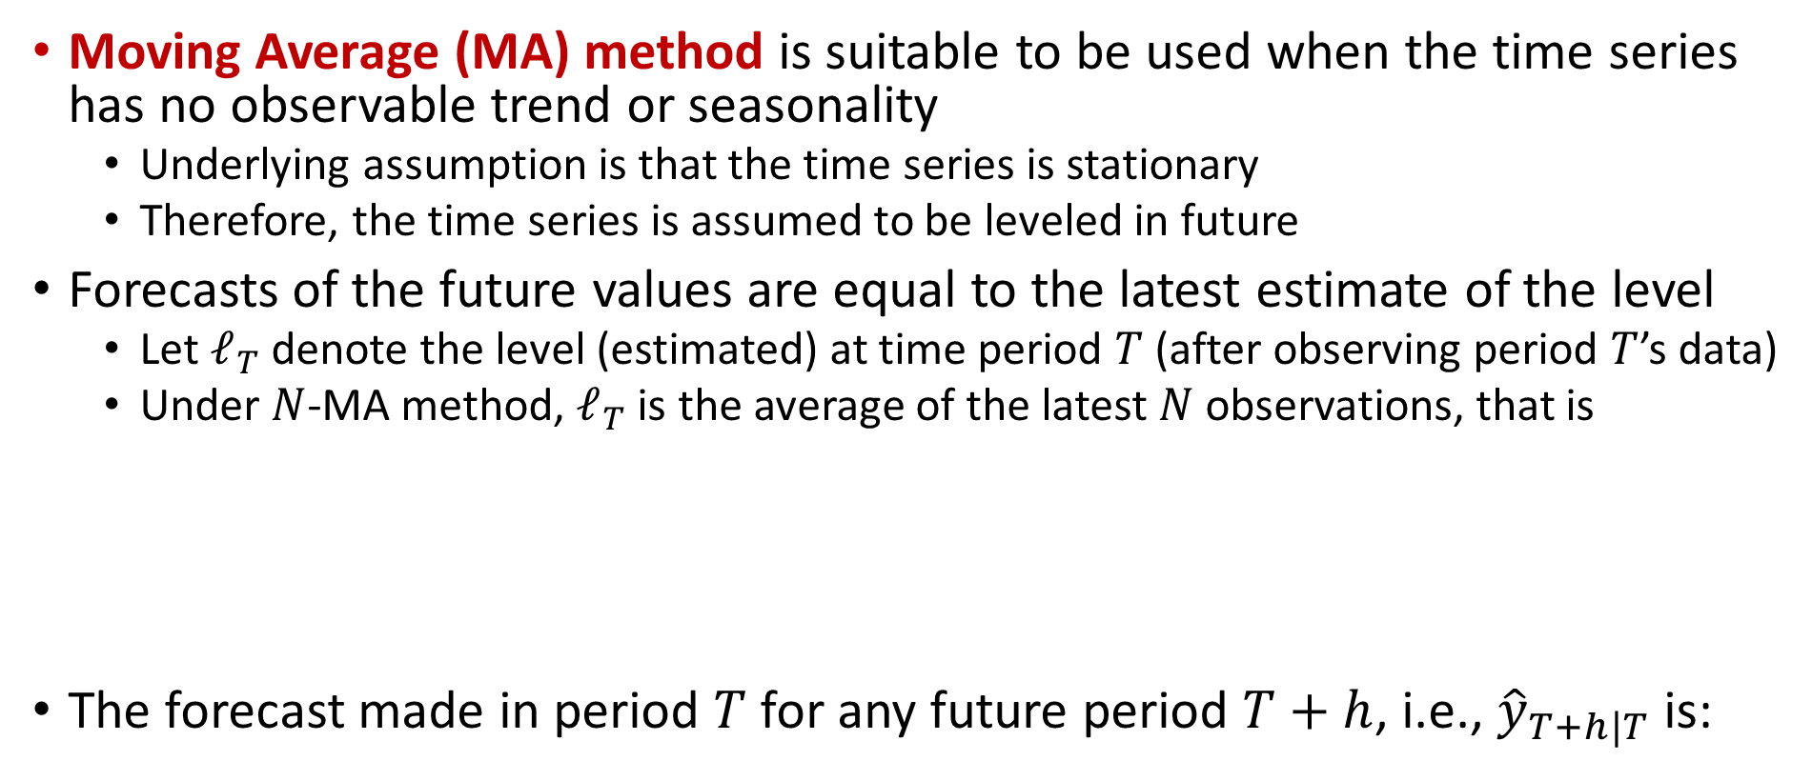
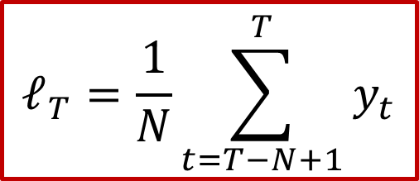
Forecasting with Moving Average Method
Moving Average (MA) method is suitable to be used when the time series has no observable trend or seasonality
  Underlying assumption is that the time series is stationary
  Therefore, the time series is assumed to be leveled in future
Forecasts of the future values are equal to the latest estimate of the level
  Let $ℓ_{T}$ denote the level (estimated) at time period $T$ (after observing period $T$’s data)
  Under $N$-MA method, $ℓ_{T}$ is the average of the latest $N$ observations, that is
The forecast made in period $T$ for any future period $T+h$, i.e., ${\hat{y}}_{T+h|T}$is:
$$ℓ_{T}=\frac{1}{N}\sum_{t=T−N+1}^{T}{y_{t}}$$
$${\hat{y}}_{T+h|T}=ℓ_{T}$$

Slide 31
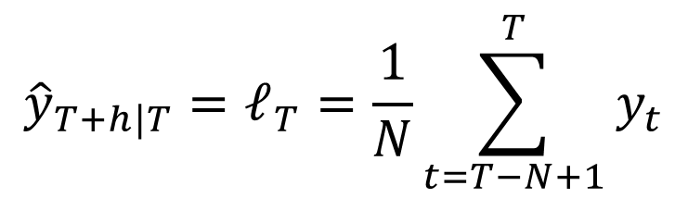
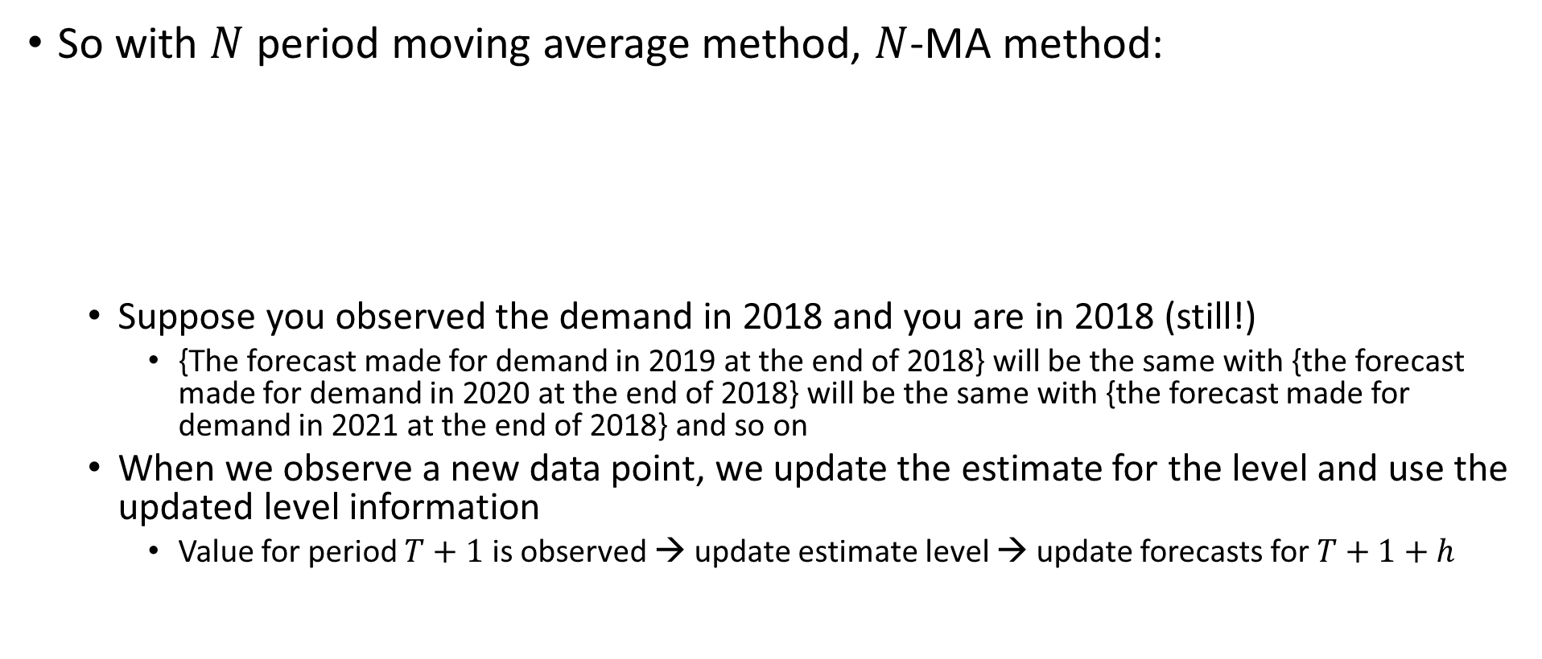
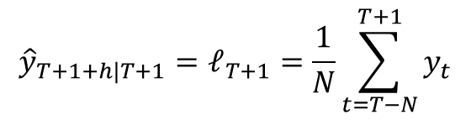

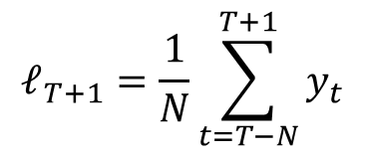
Forecasting with Moving Average Method
So with $N$ period moving average method, $N$-MA method:
  Suppose you observed the demand in 2018 and you are in 2018 (still!)
    {The forecast made for demand in 2019 at the end of 2018} will be the same with {the forecast made for demand in 2020 at the end of 2018} will be the same with {the forecast made for demand in 2021 at the end of 2018} and so on
  When we observe a new data point, we update the estimate for the level and use the updated level information
    Value for period $T+1$ is observed → update estimate level → update forecasts for $T+1+h$
$${\hat{y}}_{T+h|T}=ℓ_{T}=\frac{1}{N}\sum_{t=T−N+1}^{T}{y_{t}}$$
$$ℓ_{T+1}=\frac{1}{N}\sum_{t=T−N}^{T+1}{y_{t}}$$
$${\hat{y}}_{T+1+h|T+1}=ℓ_{T+1}=\frac{1}{N}\sum_{t=T−N}^{T+1}{y_{t}}$$
$y_{T+1}$ is observed

Slide 32
Forecasting with Moving Average Method
Example: Module 1.2 – Example – Forecasting with Moving Average Method.xlsx
Example: Module 1.2 – Example – Forecasting with Moving Average Method.xlsx
Key-point: When using Moving Average, the forecast made for the next period's demand is the average of the latest N observations (including the observation of the current period we are in)
Key-point: At the end of a period, one-step-ahead and multi-step-ahead forecasts made using Moving Average method are identical because, the underlying assumption is that the demand has no trend and no seasonality.

Slide 33
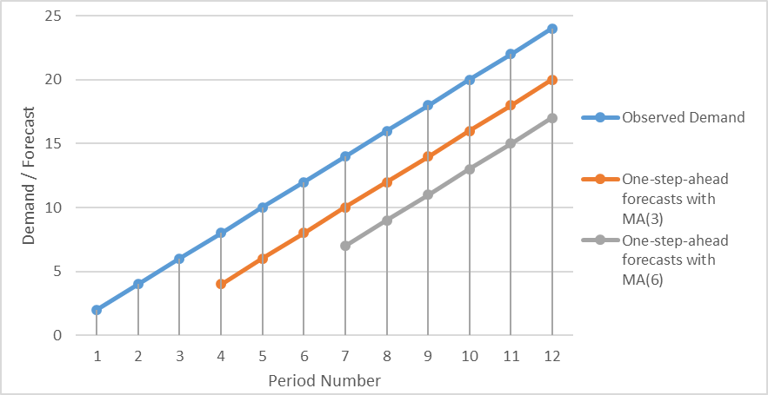
Forecasting with Moving Average Method
Example: Module 1.2 – Example – Forecasting with Moving Average Method.xlsx
Key-point: Moving Average method is suitable for data with no observable trend. If Moving Average method is used for a time-series with trend, the forecasts made will lag the trend. The bigger N is used, the bigger the gap will be; because, with smaller N, you can capture the trend by focusing more on the newer observations.

Slide 34
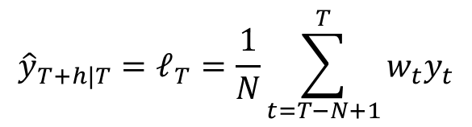



Forecasting with Moving Average Method
Moving Average Method:
  Advantages: Easily understood and computed & provides stable forecasts
  Disadvantages: Saving all $N$ past data & lags trends & ignores complexity
Moving Average Method gives equal weights to each of the $N$ previous observations
Weighted Moving Average Method:
  Gives different weights to the $N$ previous observations and uses the weighted average of the N previous observations for forecasting
  Weights should sum to 1 →
How to determine N?
  One way is to minimize forecast errors (more on this later).
$y_{t}$: past observation of period t
$${\hat{y}}_{T+h|T}=ℓ_{T}=\frac{1}{N}\sum_{t=T−N+1}^{T}{{w_{t}y}_{t}}$$
$w_{t}$: Weight assigned to past observation of period t
$$\sum_{t=T−N+1}^{T}{w_{t}}=1$$
See: Module 1.2 – Example – Forecasting with Moving Average Method.xlsx

Slide 35
Outline
Time Series
  Patterns, Graphics, Autocorrelation, and Stationarity
  Components, Moving Averages, and Decomposition
Simple Forecasting Methods
  Notation and Methods
  Forecasting with Moving Average
Forecast Errors
  Errors and Measures

Slide 36
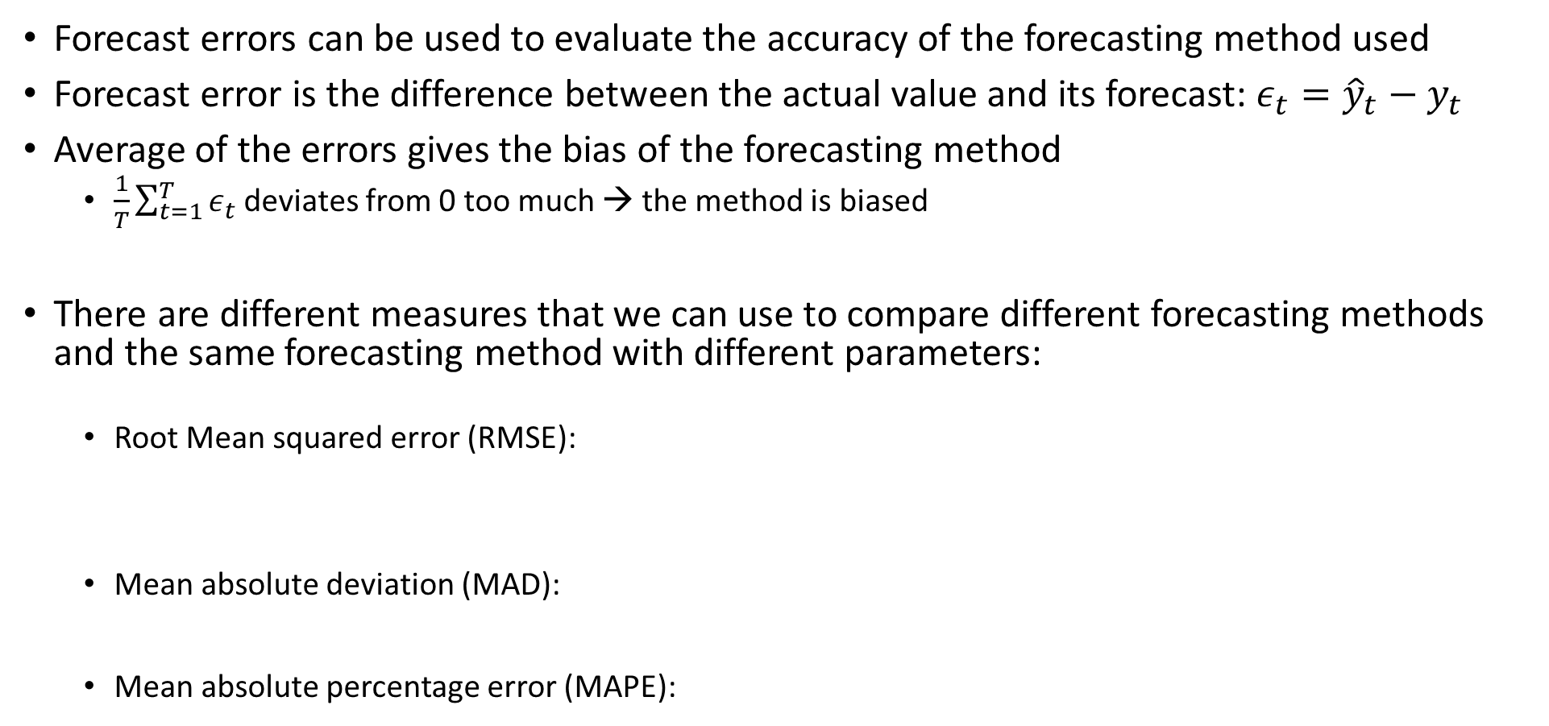



Forecast Errors
Forecast errors can be used to evaluate the accuracy of the forecasting method used
Forecast error is the difference between the actual value and its forecast: $ε_{t}={\hat{y}}_{t}−y_{t}$
Average of the errors gives the bias of the forecasting method
  $\frac{1}{T}\sum_{t=1}^{T}{ε_{t}}$ deviates from 0 too much → the method is biased
There are different measures that we can use to compare different forecasting methods and the same forecasting method with different parameters:
  Root Mean squared error (RMSE):
  Mean absolute deviation (MAD):
  Mean absolute percentage error (MAPE):
$$\sqrt{\frac{1}{T}\sum_{t=1}^{T}{ε_{t}^{2}}}$$
RMSE and MAD are scale-dependent
$$\frac{1}{T}\sum_{t=1}^{T}{|ε_{t}|}$$
$$\frac{1}{T}\sum_{t=1}^{T}{100×|ε_{t}/y_{t}|}$$

Slide 37
Forecast Errors
Different measures can indicate different results
  Example: Module 1.2 – Example – Forecasting Errors.xlsx
  Consider that 2 methods are used to forecast on the same time series.
  Forecasts for each method and observed values are given below.
These measures can be used to find good values for the parameters
  For instance, we can find N (among possible options that will minimize RMSE) for a Moving Average Method
    RMSE indicates that Method 2 is better
    MAD indicates that Method 1 is better
    MAPE indicates that Method 1 is better

